Slide 1
Printer Control & Software
By Friends & CO

Slide 2

Pre-workshop
Visit :
Marlin and G-code
http://marlinfw.org/
http://marlinfw.org/meta/gcode/
Write down Gcode movement for a square
Download and install :
PronterFace
https://www.pronterface.com/
What’s a

Slide 3
Agenda
Printer Firmware
Marlin
Marlin UI
Understanding G-code & Pronterface
Advanced
Marlin configuration
EEPROM
Flashing firmware

Slide 4
Printer Firmware
Notes:
n our case, when your 3D printer software (like Repetier Host, Cura or OctoPrint) sends G-code to your 3D printer, the firmware translates the G-code commands into specific electrical signals that are sent to the motors, heaters, fans and other components on the 3D printer.

Slide 5

Types
Open source
Repetier
Marlin - Prusa uses a modified version
Klipper
Proprietary
Dont Care :)
Notes:
Klipper offloads processing movements to external processor like a pi.
Marlin is widely used as it is feature rich and has may contributors as well as rapid development / bugfixes

Slide 6
Marlin UI

Slide 7
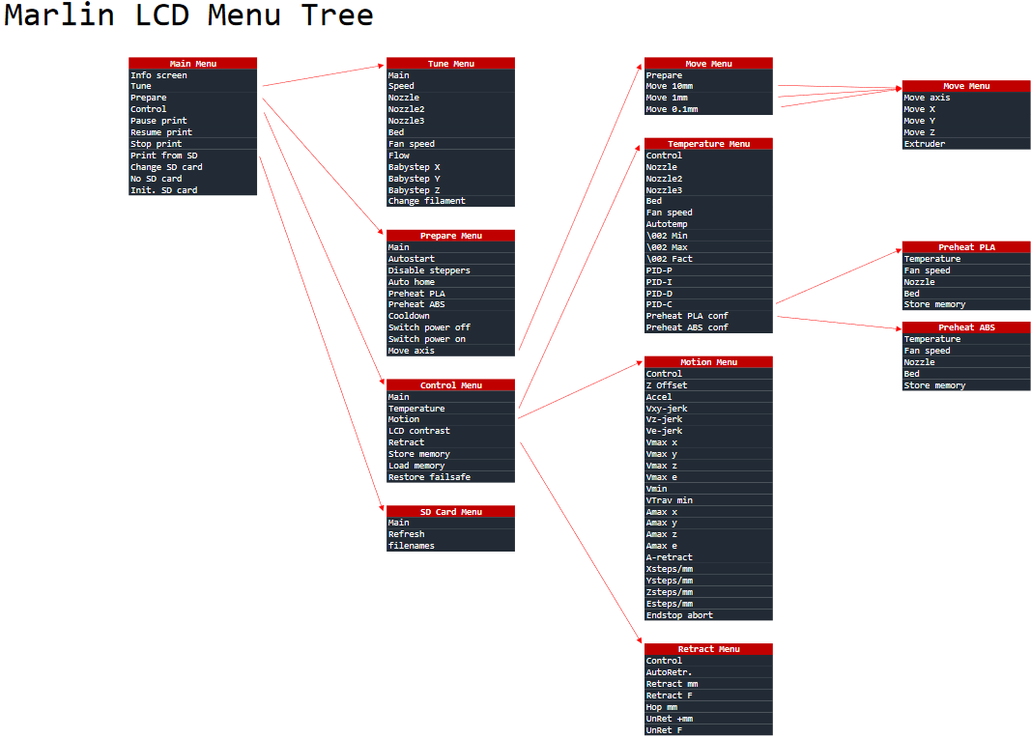
Go through the LCD interface on a Prusa , ask for help if you need it !
What are some differences in the menu shown and the prusa printers ?

Slide 8
G- code in Marlin
Over a 100 unique G code commands
Good idea to learn a few for :
troubleshooting
testing

Slide 9
Top commands
G28 – Perform Homing Routine
G90 and G91 – Set Positioning Mode
G1 – Linear Movement
G92 – Set Current Position
M104 and M109 – Extruder Heating Commands
M140 and M190 – Bed Heating Commands
M106 – Set Fan Speed
https://www.simplify3d.com/support/articles/3d-printing-gcode-tutorial/

Slide 10
Pronterface

Slide 11
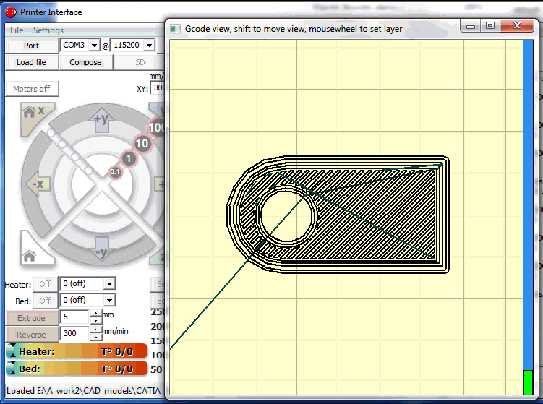
Printrun
3D printing host software suite
Can communicate with a printer and handle the printing process
Have control over most of the printers actions and remotely monitor it

Slide 12
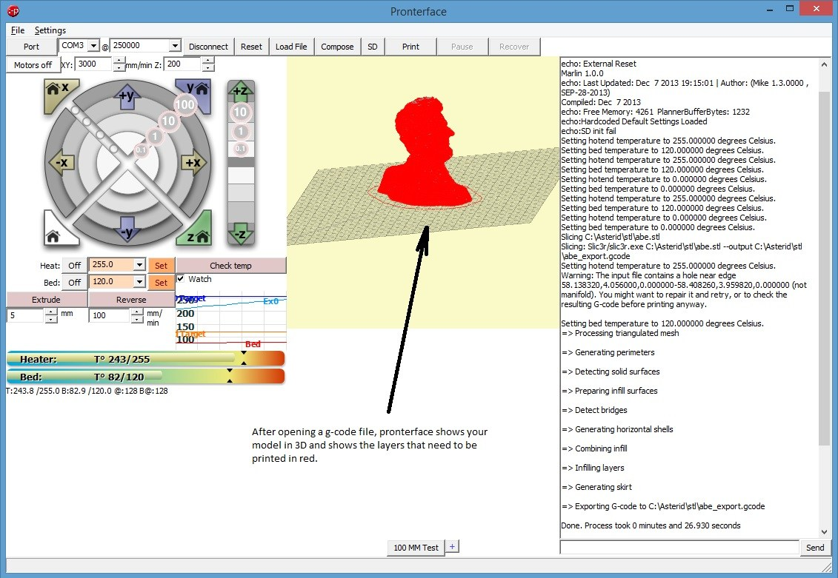
Printrun UI

Slide 13
Advanced Features & Further Reading

Slide 14
Further Reading
Marlin configuration - Marlin 2.0 and 1.1.X - http://marlinfw.org/docs/configuration/configuration.html
EEPROM - Electrically Erasable Programmable Read-Only Memory
http://marlinfw.org/docs/features/eeprom.html
Can you find EEPROM commands in the prusa menus?
Flashing firmware - Varies depend on the board - Usually requires Arduino IDE or a similar compiler
http://marlinfw.org/docs/basics/install.html

